Slide 1

Machine Learning with Kernel Methods
Telkom University
Risman Adnan Mattotorang, Ph.D

Slide 2
About This Lecture
My Goals:
Explain Kernel Methods in Casual Way
Simplify Explanations of Rigorous Mathematical Frameworks
Familiarize Practical Modeling Tools and Algorithms
Organization:
Mathematics of Kernel Methods
Supervised and Unsupervised ML Models with Kernels
Working Knowledge of Kernel Engineering

Slide 3
Outline
Kernel Overview
Hilbert Space
Positive Definite Functions
RKHS: Reproducing Kernel Hilbert Space
Kernel Tricks & Representer Theorem

Slide 4
What is Kernel Method
Machine learning model for pattern recognition (eq. SVM)
Used for clustering, PCA, correlation, classification and regression tasks
Kernel algorithms mostly based on convex optimization and eigenproblems
Essence of kernel method:
Transforming data into higher dimension (called feature space)
Feature space has a clear dividing margin between classes of data
Data transformed into “feature space” by feature map function
Kernel is similiarity measure of pairwise comparison of data points

Slide 5
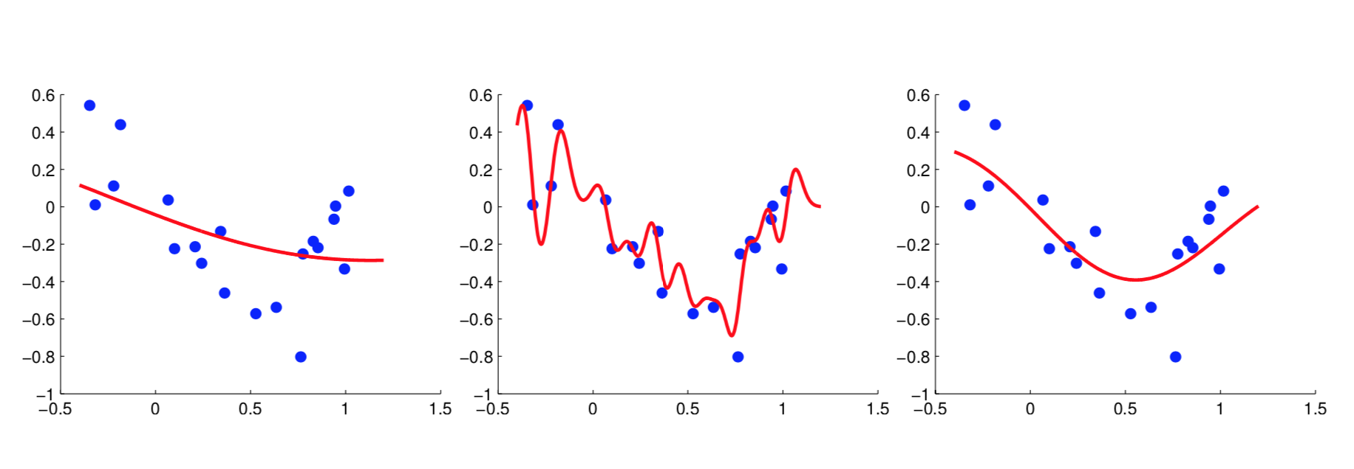
Why Kernel Method
Kernel methods can control smoothness and avoid overfitting/underfitting.

Slide 6
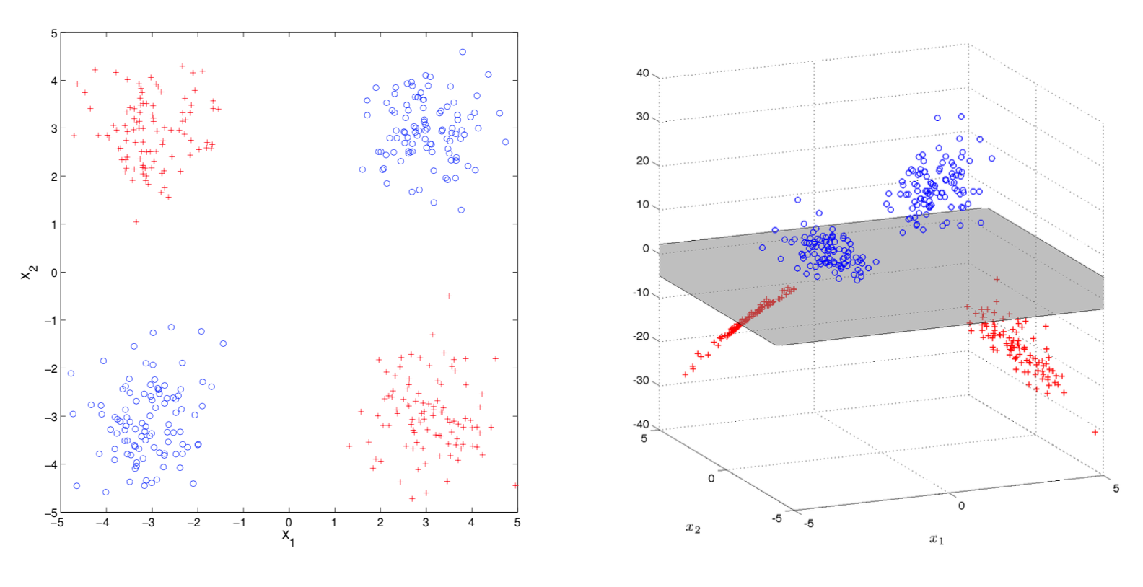
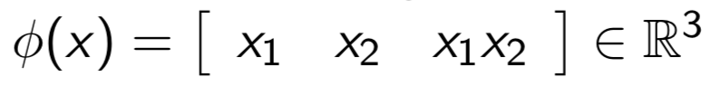

XOR Transformation
$$φ$$
No linear classifier separates red from blue.
Map to points to higher dimension feature space

Slide 7
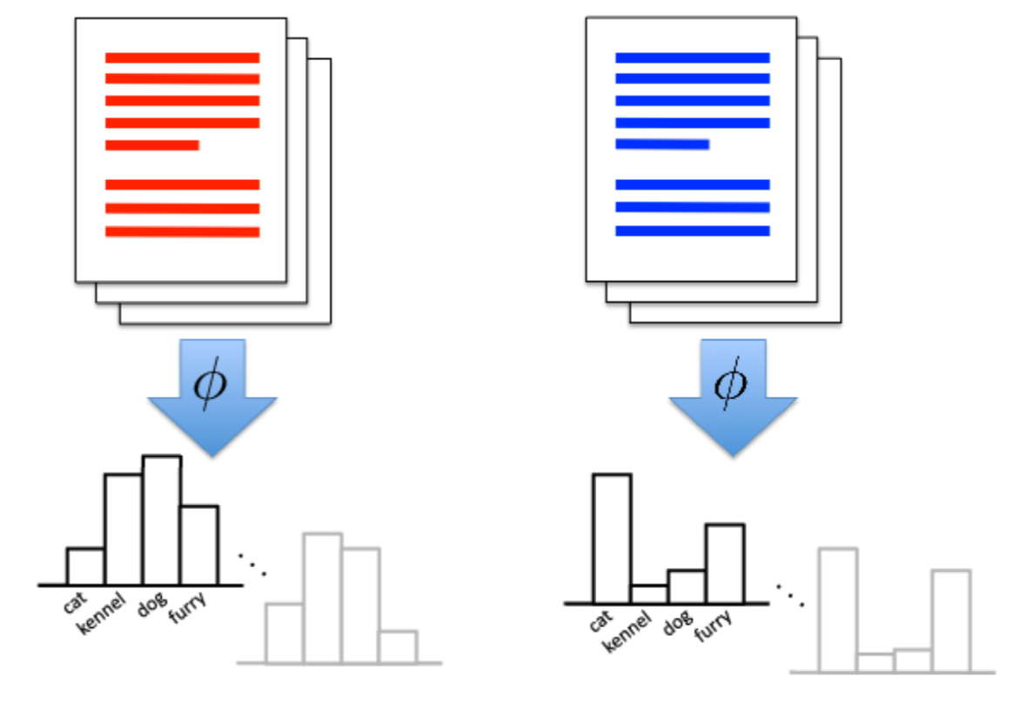
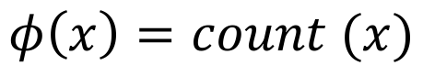
Histogram Transformation
$$φ\left(x\right)=count (x)$$
Counts of objects inside a text turn into histogram
Kernel let us compare objects on basis of features

Slide 8
Kernel Method Approach
Motivation
Develop a versatile algorithms to process and analyze data…..
… without making any assumptions regarding the type of data (vectors, strings, graphs, images, …)
The Approach
Develop methods based on pairwise comparisons.
By imposing constraints on the pairwise comparison function (positive definite kernels), we obtain a general framework for learning from data (optimization in higher dimension or feature space).

Slide 9

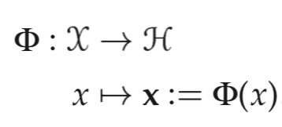
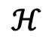
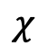
Representation by Pairwise Comparison
$$χ$$
$$ℋ$$
Good generalization requires “similarity measures” of data points in both spaces.
Similiarity measure of data points in input space is a deep question in ML.

Slide 10
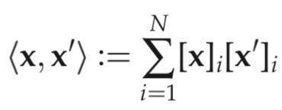
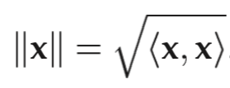
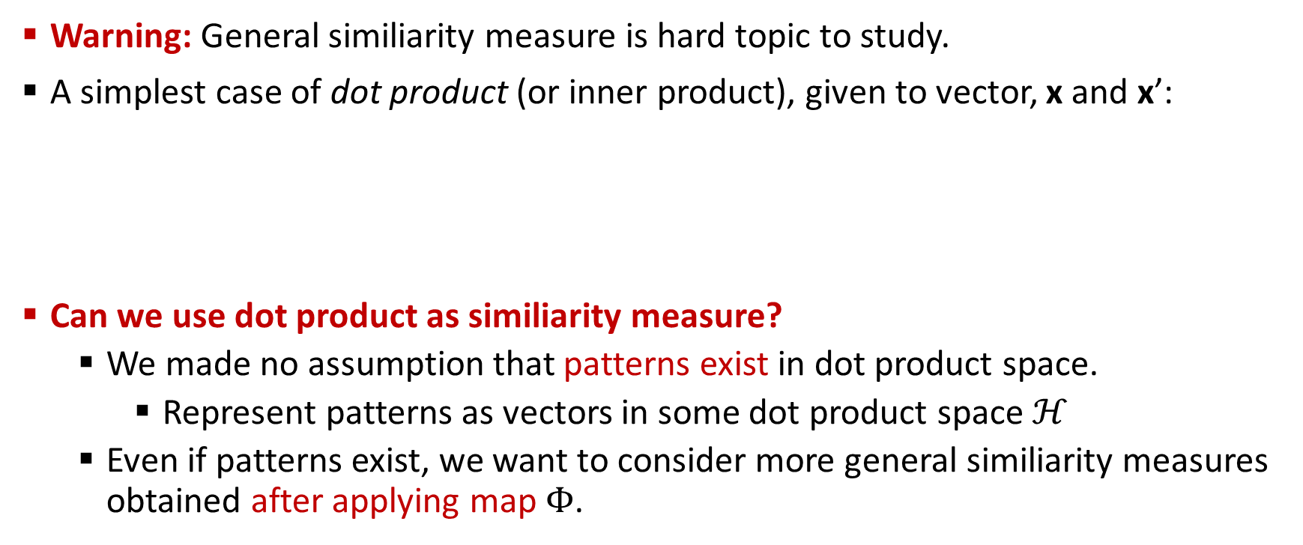
Similiarity Measure
Warning: General similiarity measure is hard topic to study.
A simplest case of dot product (or inner product), given to vector, x and x’:
Can we use dot product as similiarity measure?
We made no assumption that patterns exist in dot product space.
Represent patterns as vectors in some dot product space $ℋ$
Even if patterns exist, we want to consider more general similiarity measures obtained after applying map $Φ$.
with norm

Slide 11
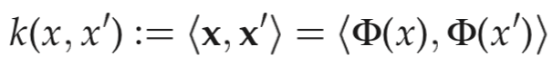
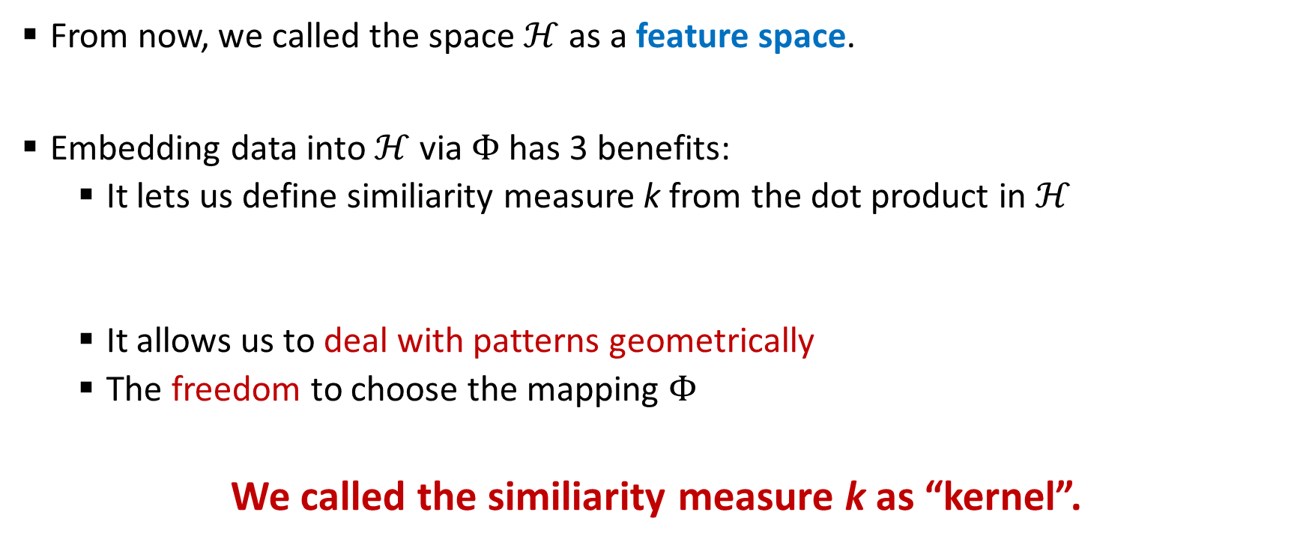
Kernel as Similiarity Measure
From now, we called the space $ℋ$ as a feature space.
Embedding data into $ℋ$ via $Φ$ has 3 benefits:
It lets us define similiarity measure k from the dot product in $ℋ$
It allows us to deal with patterns geometrically
The freedom to choose the mapping $Φ$
We called the similiarity measure k as “kernel”.

Slide 12
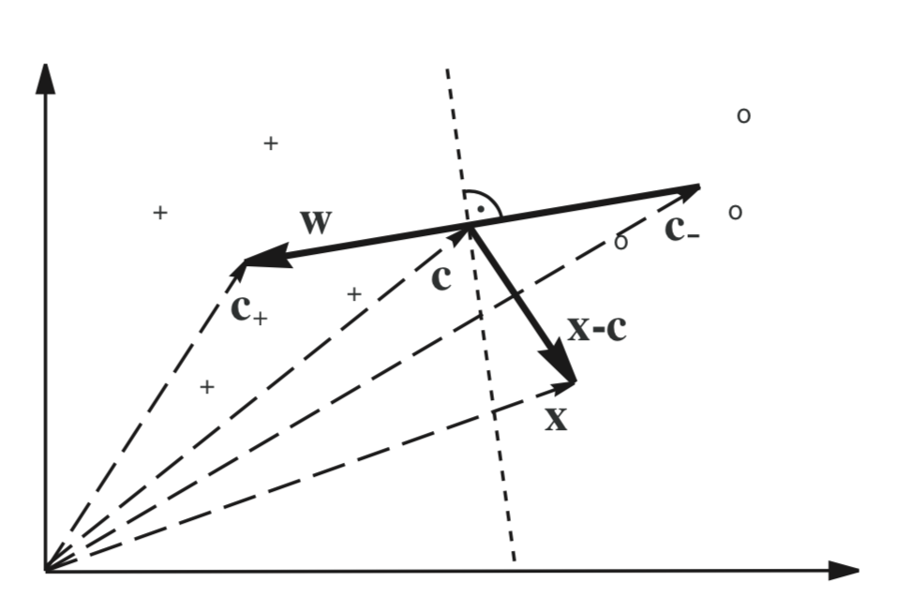
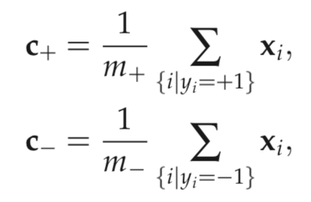
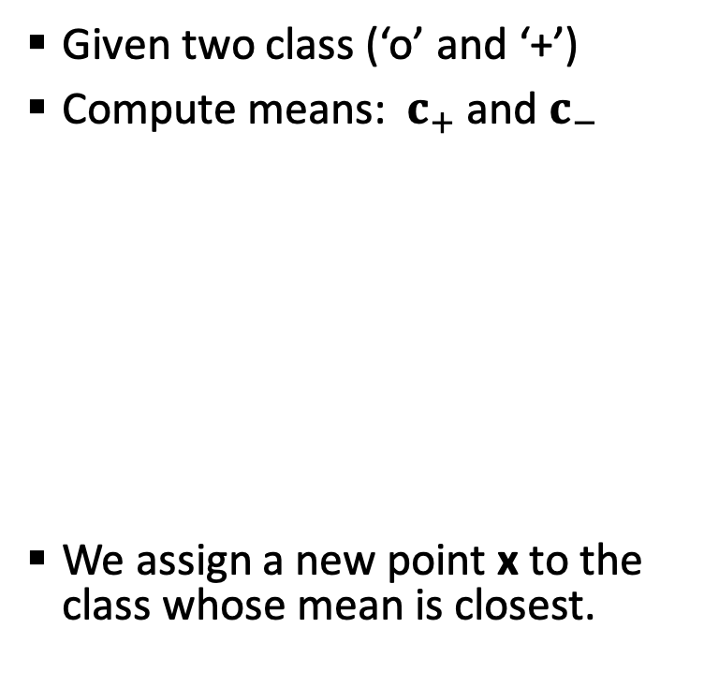
A Simple Geometric Classification
Given two class (‘o’ and ‘+’)
Compute means: $c_{+}$ and $c_{−}$
We assign a new point x to the class whose mean is closest.

Slide 13
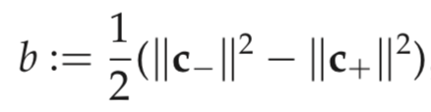
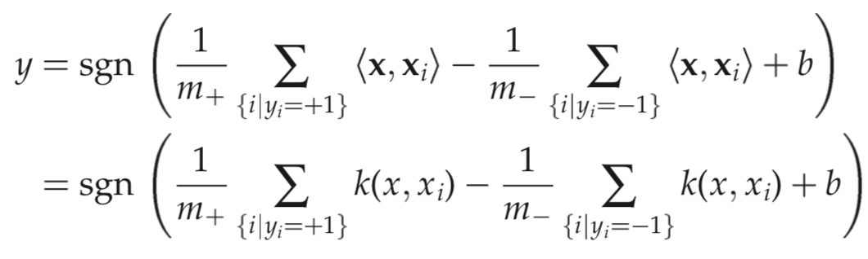
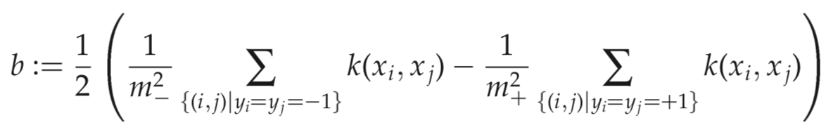
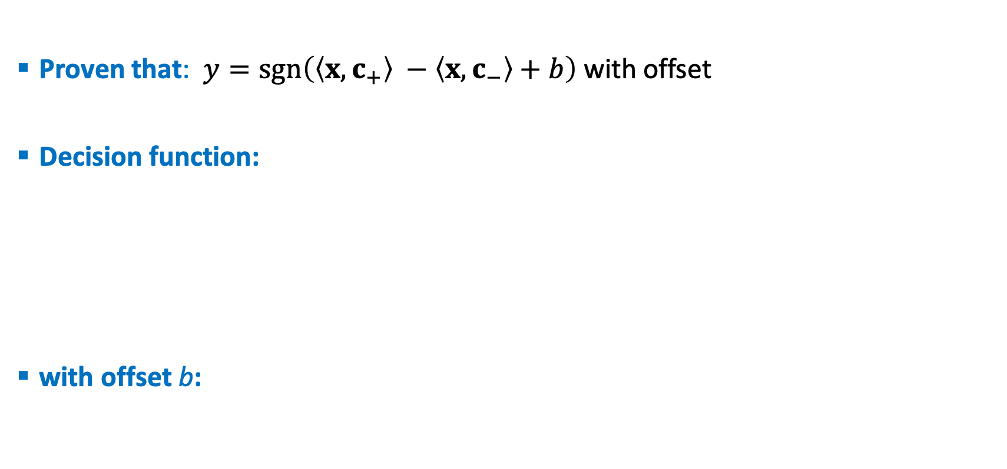
With Some Little Math
Proven that: $y=sgn\left(\left\langle x,c_{+}\right\rangle −\left\langle x,c_{−}\right\rangle +b\right)$ with offset
Decision function:
with offset b:
Surprisingly, both can be represent by dot product kernel!

Slide 14
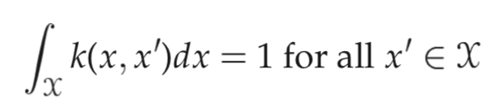
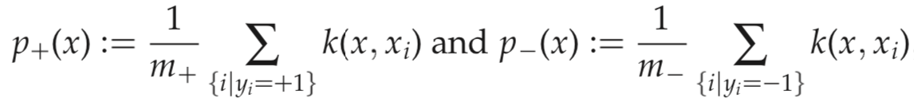
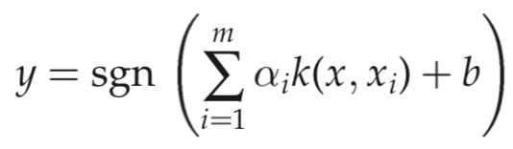
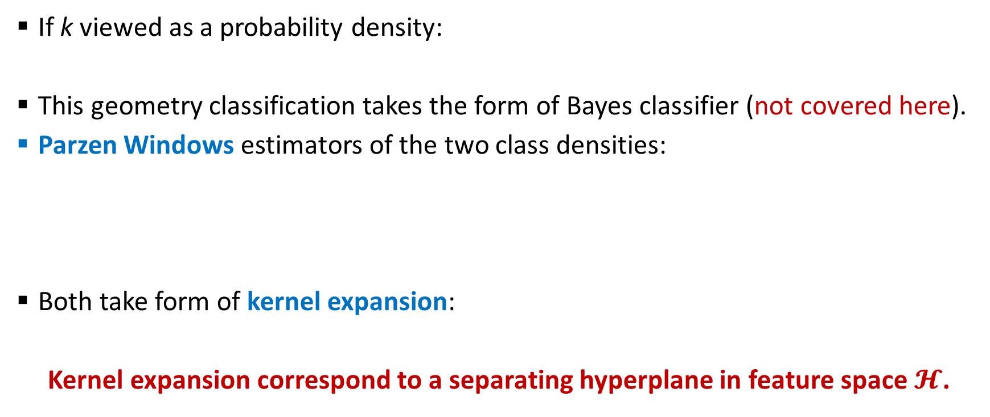
Kernel Expansion Idea
If k viewed as a probability density:
This geometry classification takes the form of Bayes classifier (not covered here).
Parzen Windows estimators of the two class densities:
Both take form of kernel expansion:
Kernel expansion correspond to a separating hyperplane in feature space $𝓗$.

Slide 15
Outline
Kernel Overview
Hilbert Space
Positive Definite Functions
RKHS: Reproducing Kernel Hilbert Space
Kernel Tricks & Representer Theorem

Slide 16
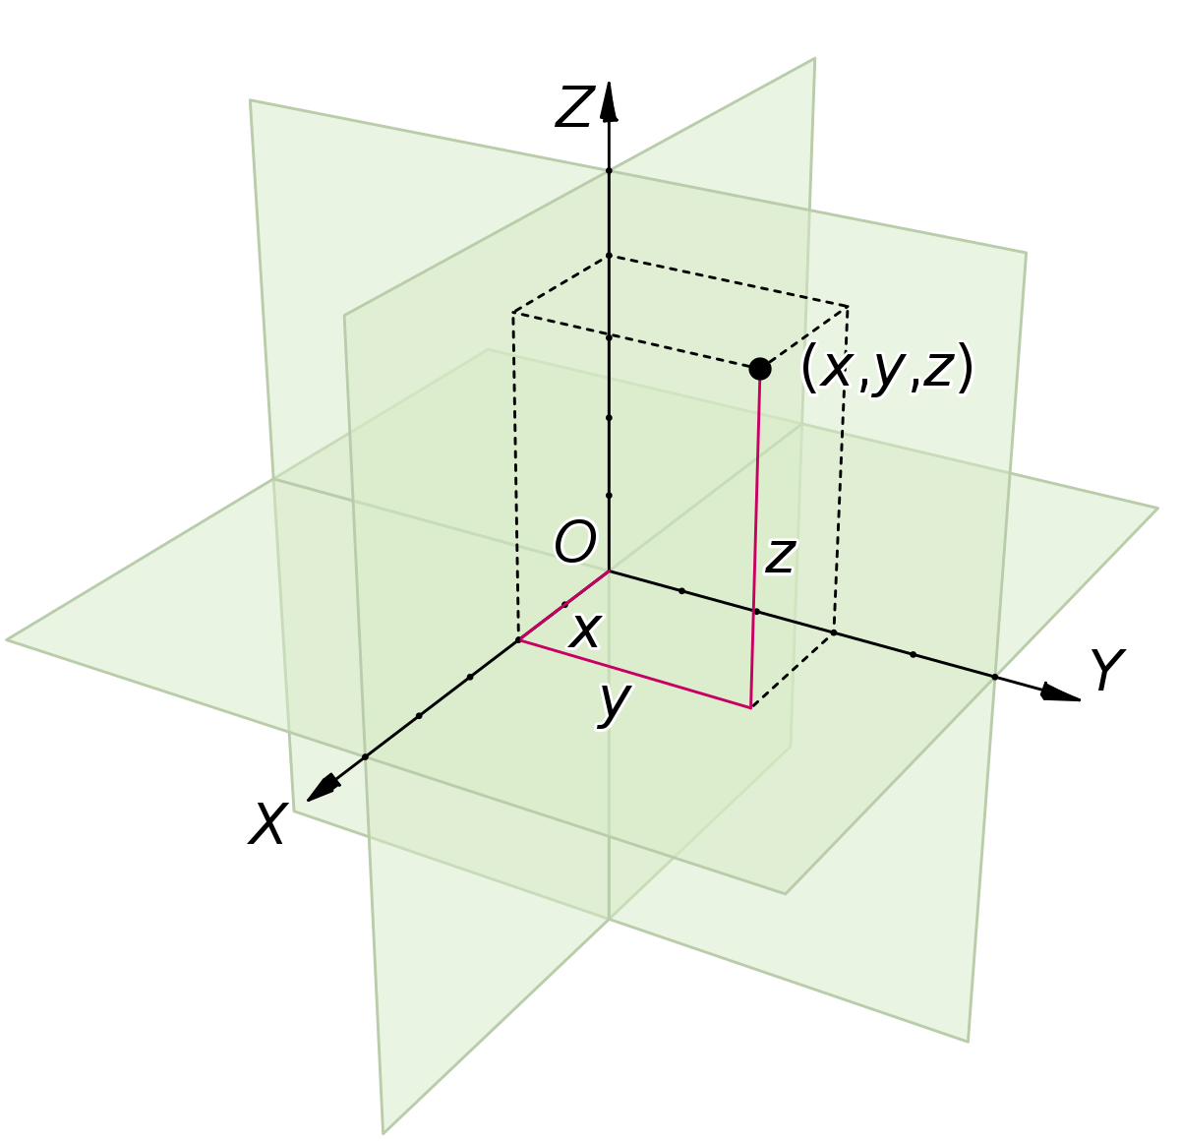
Intuition for Geometry Spaces
Euclidean: A set of points satisfying certain relationships, expressible in term of distance and angle. Key operations/motions: translation and rotation. Euclidean is very intuitive for us, but we can define more spaces with different characteristics and behaviours.
Hilbert: An abstract vector space possessing the structure of an inner product that allows length and angle to be measured. Hilbert spaces are complete inner product space, there are enough limits in the space to allow the techniques of calculus to be used. Lebesgue, Sobelev, Hardy and Bergman are subsets of Hilbert spaces.
Banach: A complete normed vector space allows the computation of vector length and distance between vectors and is complete in the sense that a Cauchy Sequence of vectors always converges to a well defined limit that is within the space.

Slide 17
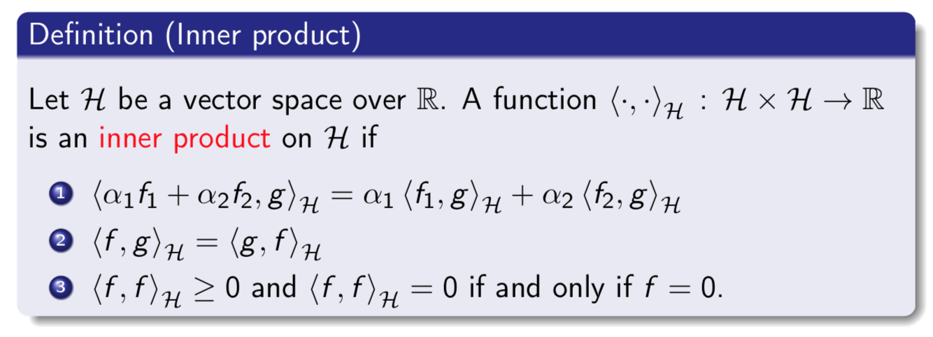
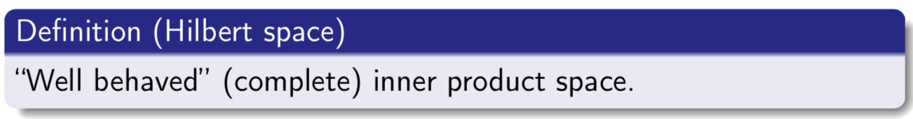
Hilbert Space

Slide 18
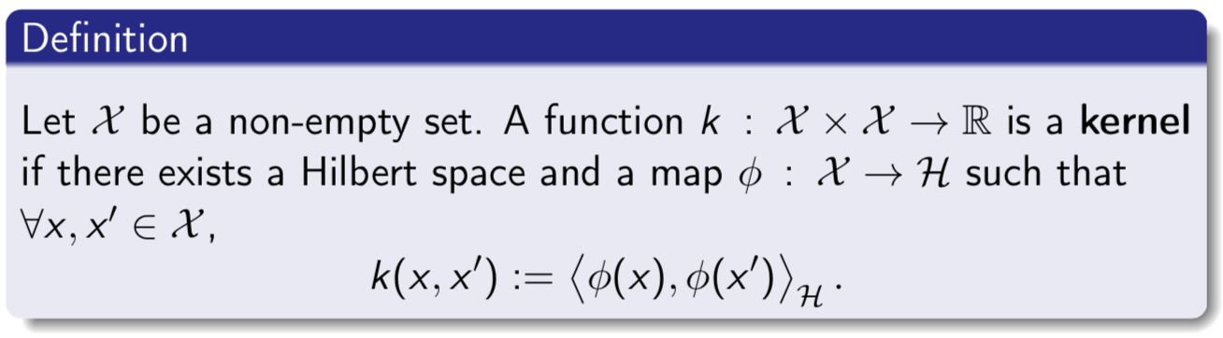
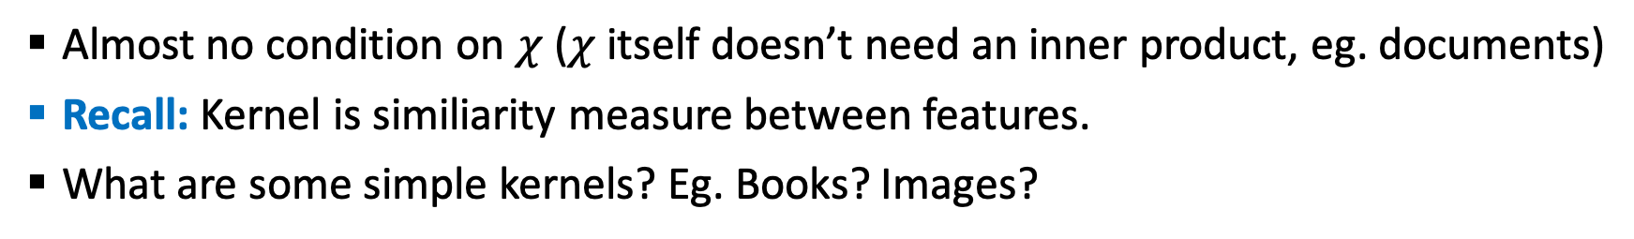
Kernel: Inner Product Between Feature Maps
Almost no condition on $χ$ ($χ$ itself doesn’t need an inner product, eg. documents)
Recall: Kernel is similiarity measure between features.
What are some simple kernels? Eg. Books? Images?

Slide 19
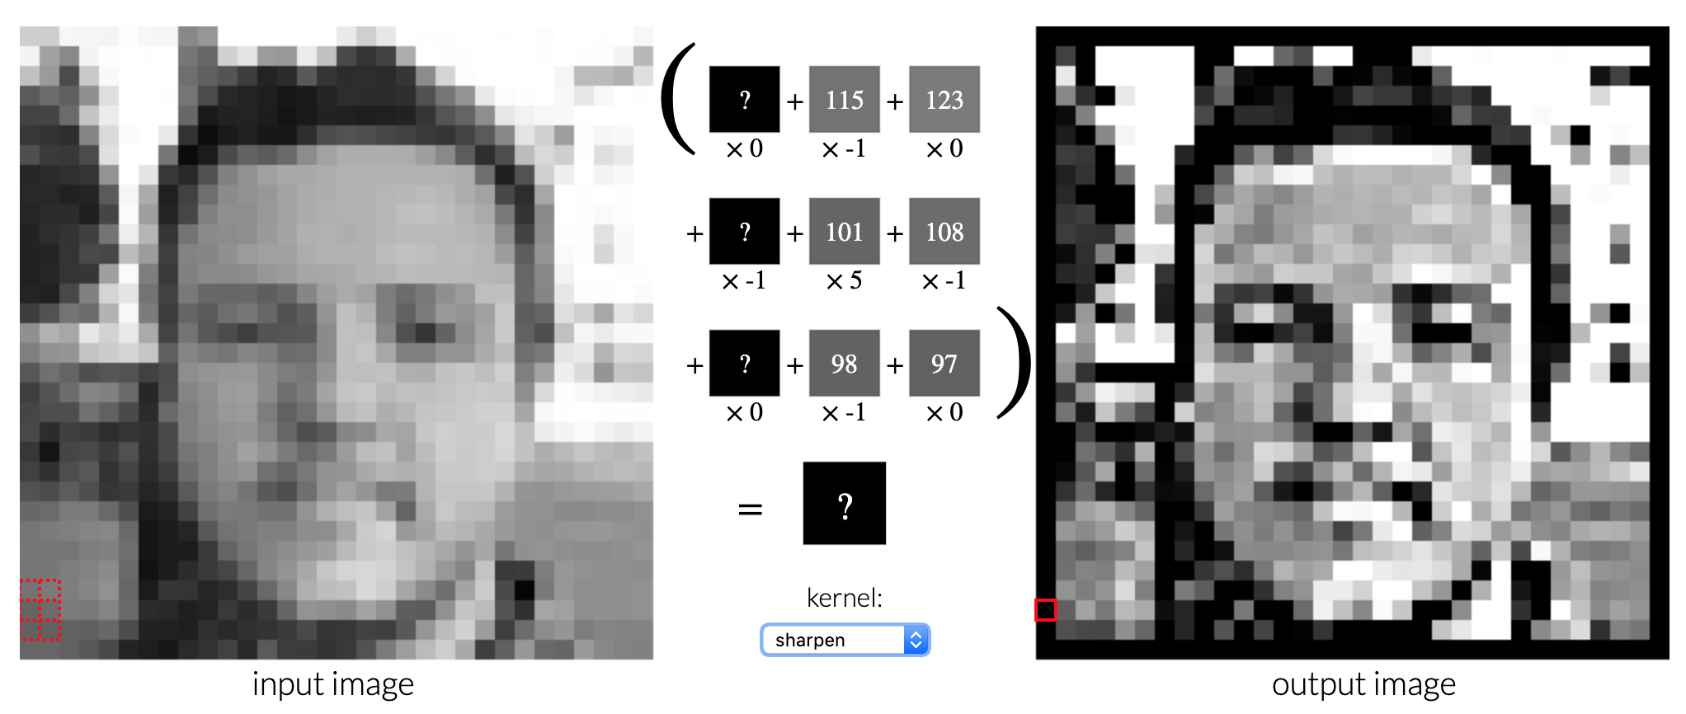
Images Kernel
Try at http://setosa.io/ev/image-kernels/

Slide 20
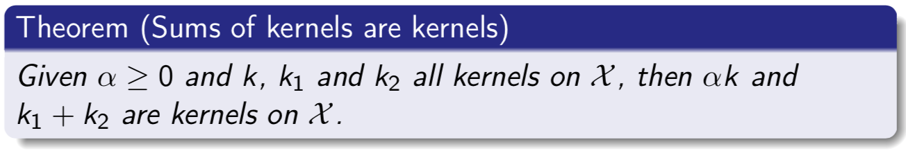
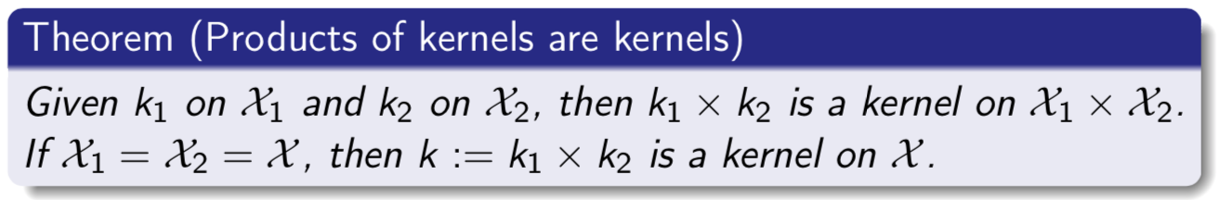
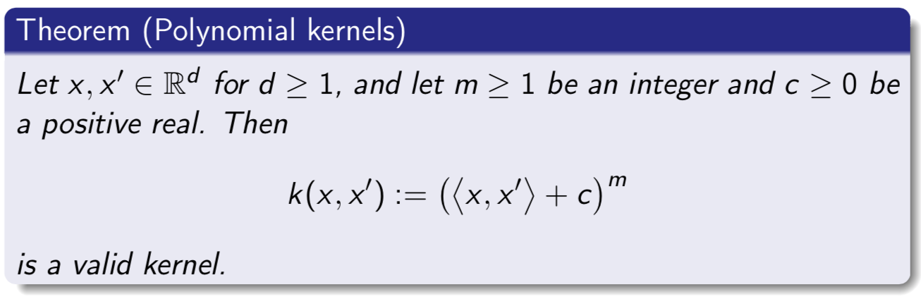
Theorem: New Kernels from Old
Sums and Transformations
Products
Polynomial Kernels
Note: we skip all proofs in this casual lecture.

Slide 21
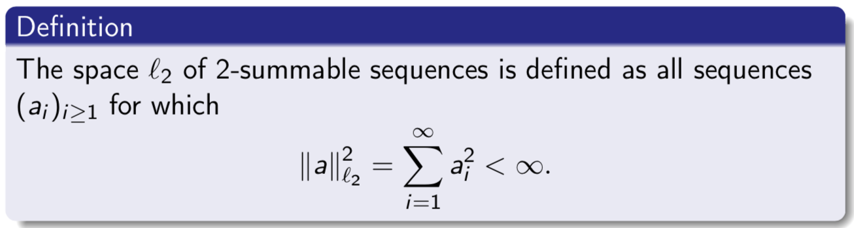
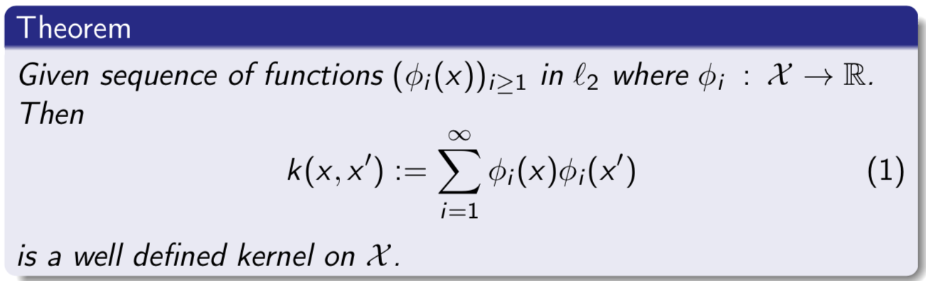
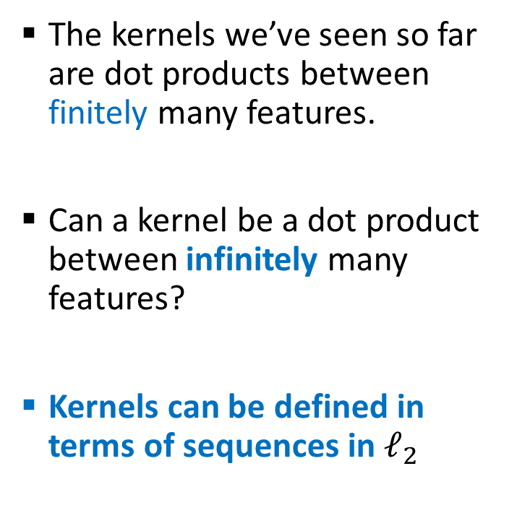
Theorem: Infinite Sequences
The kernels we’ve seen so far are dot products between finitely many features.
Can a kernel be a dot product between infinitely many features?
Kernels can be defined in terms of sequences in $ℓ_{2}$
Note: we skip all proofs in this casual lecture.

Slide 22
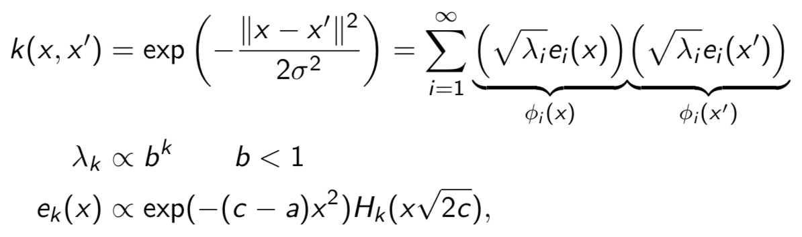
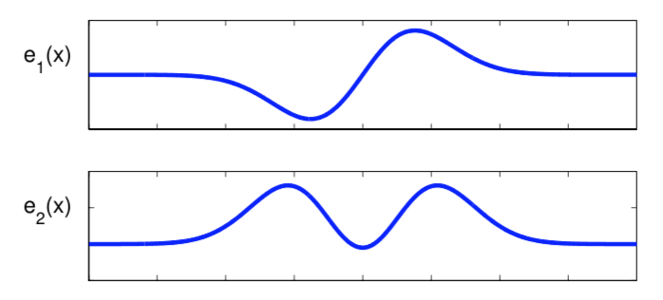
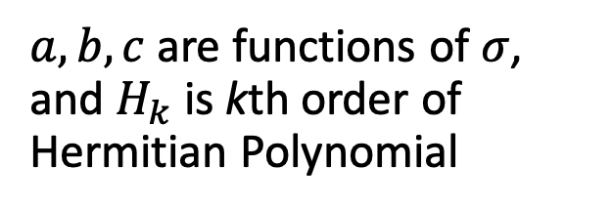
A Famous Infinite Feature Space Kernel
Gaussian Kernel:
$a,b,c$ are functions of $σ$, and $H_{k}$ is kth order of Hermitian Polynomial

Slide 23
Outline
Kernel Overview
Hilbert Space
Positive Definite Functions
RKHS: Reproducing Kernel Hilbert Space
Kernel Tricks & Representer Theorem

Slide 24
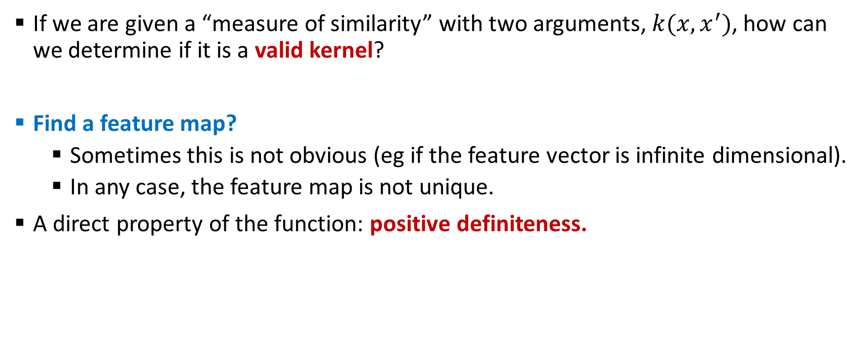
Positive Definite Functions
If we are given a “measure of similarity” with two arguments, $k(x,x^{′})$, how can we determine if it is a valid kernel?
Find a feature map?
Sometimes this is not obvious (eg if the feature vector is infinite dimensional).
In any case, the feature map is not unique.
A direct property of the function: positive definiteness.

Slide 25
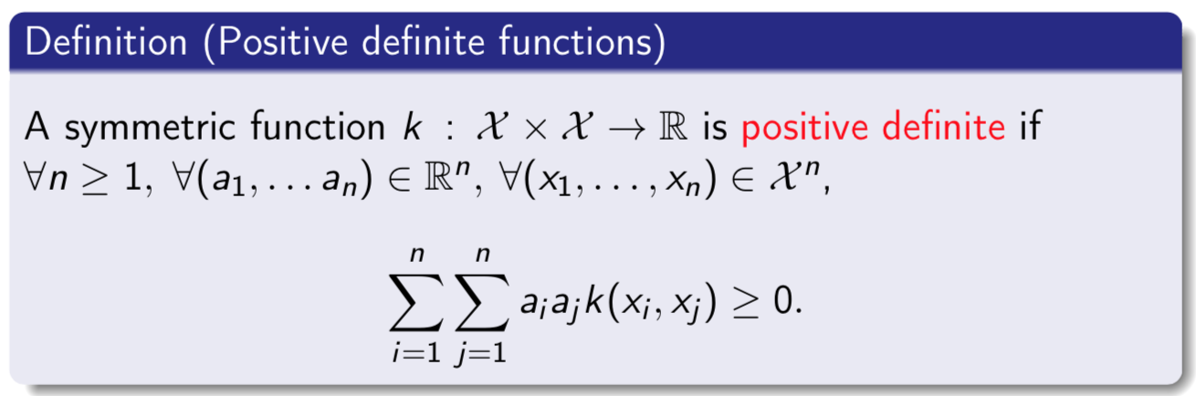
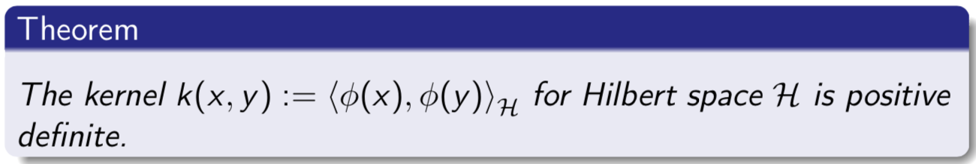
Kernels are Positive Definite
Why do we care? One good reason: it makes optimization much easier.
Kernel methods are using many algorithms that take such matrices as input.

Slide 26
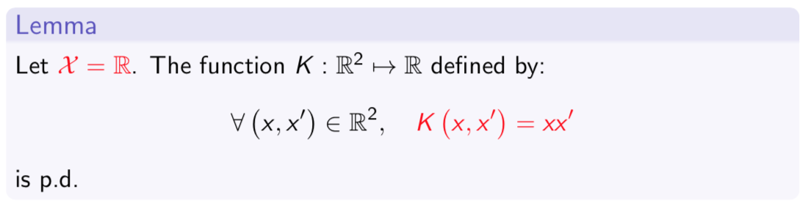
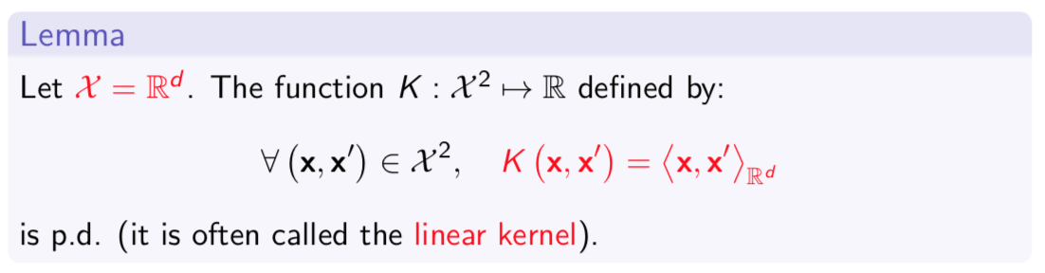
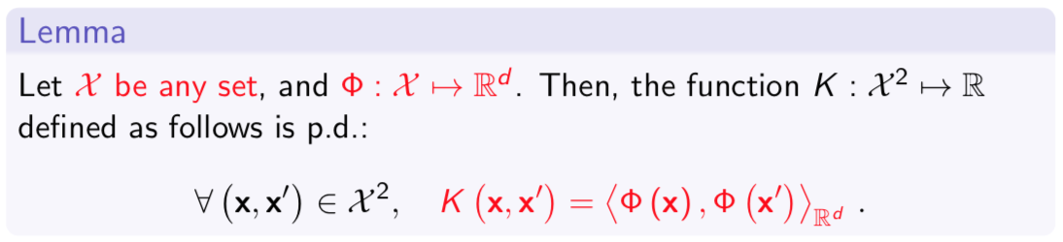
Simplest to More Ambitious p.d. Kernel
Real numbers
Vectors
Polynomials
Note: we skip all proofs in this casual lecture.

Slide 27
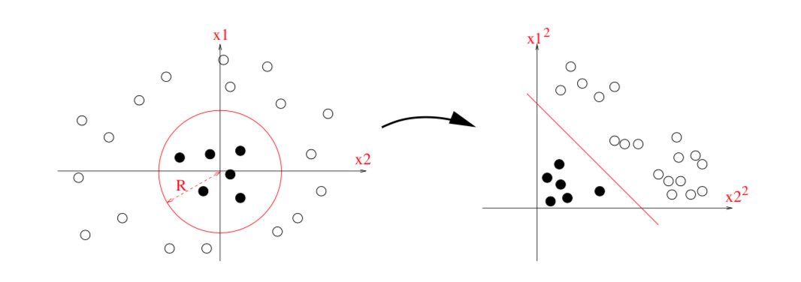
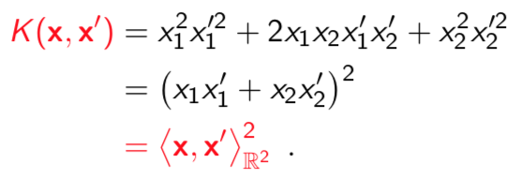
Example: Polynomial Kernel

Slide 28
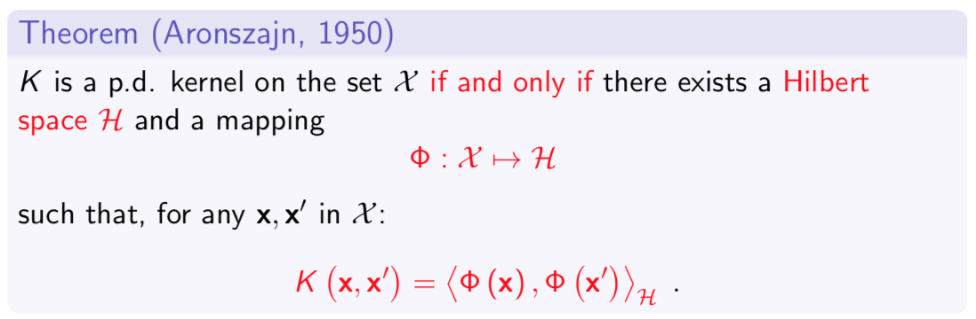
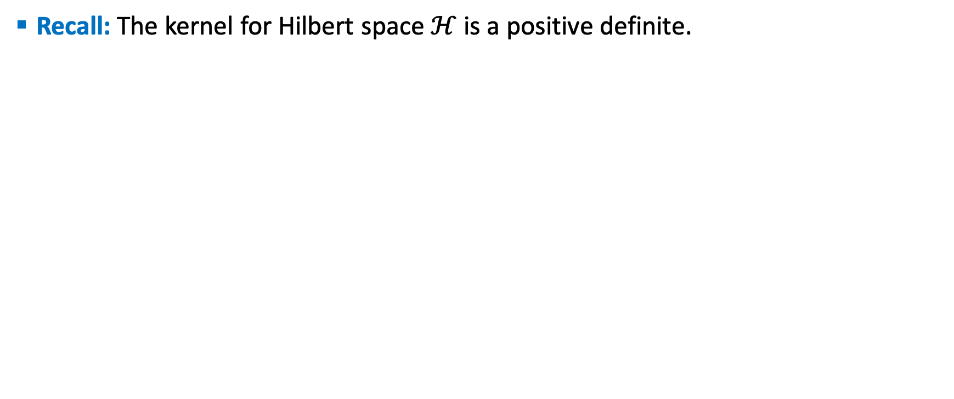
Conversely: Kernel as Inner Products
Recall: The kernel for Hilbert space $ℋ$ is a positive definite.

Slide 29
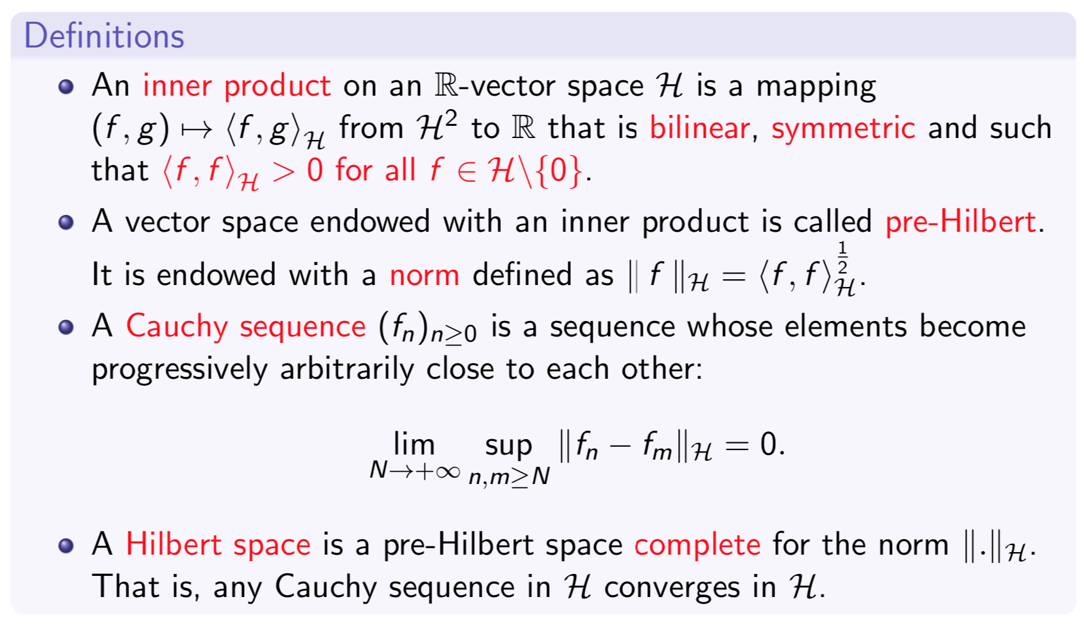
Completeness Property
Completeness is necessary to keep “good” convergence properties of Euclidean spaces in an infinite-dimensional context!

Slide 30
Outline
Kernel Overview
Hilbert Space
Positive Definite Functions
RKHS: Reproducing Kernel Hilbert Space
Kernel Tricks & Representer Theorem

Slide 31




First Example: Finite Space, Polynomial
Recall: XOR Example
Feature Space $ℋ$
with kernel

Slide 32




First Example: Finite Space, Polynomial
Define a linear function of input and their product:
$f$ in space functions mapping from $χ=ℝ^{2}$ to $ℝ$.
Equivalent representation for $f:$
$f(.)$ refers to the function as an object (here as vector in $ℝ^{3}$)
We called f as “pattern function” or “RKHS function”
$f(x)∈ℝ$ is function evaluated at point (a real number)
Evaluation of f at x is an inner product in feature space (here in $ℝ^{3})$
$ℋ$ is a space of functions mapping $ℝ^{2}$ to $ℝ$

Slide 33

Why Pattern Function Important?

Slide 34



What About Infinitely Many Features?
Gaussian Kernel:

Slide 35



What About Infinitely Many Features?
Function with Gaussian Kernel:
Much more convenient way to write functions of infinitely many features!

Slide 36



The Reproducing Property
We can write without ambiguity:
The two defining features for RKHS (Reproducible Kernel Hilbert Space):
The Reproducing Property:
The Feature Map of Every Function is a Function:

Slide 37





A Closer Look to Gaussian Kernel
Gaussian Kernel:
RKHS function, Gaussian kernel:
where
Note that this enforce smoothing.
$λ_{k}$decay as $e_{k}$ become rougher.
$f_{j}$ decay since $\sum_{j}{f_{j}^{2}}<∞$ .

Slide 38

RKHS Definition
Why do we care about RKHS?
The principle of RKHS gives us a simple recipe to do machine learning:
Map data into higher dimension (RKHS) through kernel mapping
Perform machine learning optimization in the RKHS

Slide 39

An Equivalent Definition of RKHS

Slide 40


Uniqueness of RKHS

Slide 41

Smoothness Functional
Important: Small Norm ➔ Slow Variations

Slide 42

Kernel and RKHS: Summary

Slide 43
Outline
Kernel Overview
Hilbert Space
Positive Definite Functions
RKHS: Reproducing Kernel Hilbert Space
Kernel Tricks & Representer Theorem

Slide 44



Motivation from Supervised Learning
Two theoretical results underpin algorithms of kernel methods:
Kernel trick: the representation of p.d. kernels as inner products;
Representer Theorem: properties of regularization defined by RKHS norm.
For instance, in supervised learning, the goal is to learn a prediction function f:

Slide 45
Motivation from Supervised Learning
Kernel methods map data to a Hilbert space and work with linear forms:
First purpose: embed data in a vectorial space where
Many geometrical operations exist (angle computation, projection on linear subspaces, definition of barycenters....).
We can learn potentially rich infinite-dimensional models.
Regularization is natural and theoretically grounded.
The principle is generic and does not assume anything about the nature of the set X (vectors, sets, graphs, sequences).
Second purpose: unhappy with the current Euclidean structure?
Lift data to a higher-dimensional space with nicer properties (e.g., linear separability, clustering structure).

Slide 46

The Kernel Trick
Remarks:
The proof of this proposition is trivial, because the kernel is exactly the inner product in the feature space.
This trick has huge practical applications.
Vectors in the feature space are only manipulated implicitly, through pairwise inner products.

Slide 47


Example: Computing Distance
Computing Distance
Distance for Gaussian Kernel

Slide 48



Example: Distance Between a Point and a Set
A Solution:
Map all points to the feature space
Summarize S by the barycenter of the points:
Define the distance between x and S by:

Slide 49


Computation

Slide 50


Illustration
The barycenter may carry a lot of information about the training data.

Slide 51

Basic Application in Discrimination

Slide 52
Kernel Trick Summary
The kernel trick is a trivial statement with important applications.
It can be used to obtain nonlinear versions of well-known linear algorithms, e.g., by replacing the classical inner product by a Gaussian kernel.
It can be used to apply classical algorithms to non vectorial data (e.g., strings, graphs) by again replacing the classical inner product by a valid kernel for the data.
It allows in some cases to embed the initial space to a larger feature space and involve points in the feature space with no pre-image (e.g., barycenter).

Slide 53

The Theorem
Two important consequences:
Theoretically, the minimization will enforce the norm to be “small”, which can be beneficial by ensuring a sufficient level of smoothness for the solution (regularization effect).
Practically, we know by the representer theorem that the solution lives in a subspace of dimension n, which can lead to efficient algorithms although the RKHS itself can be of infinite dimension.

Slide 54






Practical Use of The Representer Theorem
We look for a solution of the form:
For any $j=1,…n$ we have:
Furthermore, norm:
Therefore, a problem of the form:
is equivalent to n-dimensional optimization problem:
This problem can usually be solved analytically or by numerical methods;

Slide 55

Final Remark
The representer theorem has important consequences, but it is in fact rather trivial. We are looking for a function f in $ℋ$ such that for all x in $χ$, $f\left(x\right)={<K_{x},f>}_{ℋ}$. The part $f^{⊥}$ that is orthogonal to the $K_{xi}$ ‘s thus “useless” to explain the training data.

Slide 56
What Next in W2 Kernels Methods: Supervised Learning
We will learn some supervised pattern analysis (PA) models

Slide 57



References
Kernel Method Lectures:
Arthur Gretton, Reproducing Kernel Hilbert Spaces in Machine Learning
Julien Mairal, Machine Learning with Kernel Method
Academic Books:

